Slide 1
Impact of Domain Changes on
Task-oriented Dialogue Systems
Tiziano Labruna
Fondazione Bruno Kessler, Trento
Free University of Bolzano-Bozen
tlabruna@fbk.eu
Bernardo Magnini
Fondazione Bruno Kessler, Trento
magnini@fbk.eu

Slide 2


MOTIVATIONS
Task-oriented Dialogue Systems
I want to find a restaurant in the centre
There are over 50 such restaurants spanning from indian to italian food

Slide 3



Data Driven Conversational Systems
MOTIVATIONS
Training Dialogues
Domain Knowledge Base
Expert / Crowd
DST
model
DP
model
NLG
model
User
Dialogue State Tracking
Dialogue Policy
Natural Language Generation

Slide 4

Data Driven Conversational Systems
MOTIVATIONS
Training Dialogues
Domain Knowledge Base
USER: I am looking for a european food restaurant
in the expensive price
range. Can you help with
that?
SYS: There are 5 of those. What area do you want to dine in?
USER: In the centre of town please.
SYS: How about Eraina? Shall I book you a table?
USER: Yes, please. It will be just me and I’d like to eat at 21:00 on the same day as my train.
SYS: OK, I’ve got you booked. The reference number is VMNDMKV2 and they’ll hold you table for 15 minutes.
...
SLOT-NAME
Expert / Crowd
SLOT-VALUE
DST
model
DP
model
NLG
model
[
{“name”: “Eraina”,
“food”: “european”,
“price”: “expensive”,
...
},
...
]
User
Dialogue State Tracking
Dialogue Policy
Natural Language Generation

Slide 5
Data Driven Conversational Systems
MOTIVATIONS
Training Dialogues
Domain Knowledge Base
USER: I am looking for a european food restaurant
in the expensive price
range. Can you help with
that?
SYS: There are 5 of those. What area do you want to dine in?
USER: In the centre of town please.
SYS: How about Eraina? Shall I book you a table?
USER: Yes, please. It will be just me and I’d like to eat at 21:00 on the same day as my train.
SYS: OK, I’ve got you booked. The reference number is VMNDMKV2 and they’ll hold you table for 15 minutes.
...
Expert / Crowd
INSTANCE
DST
model
DP
model
NLG
model
[
{“name”: “Eraina”,
“food”: “european”,
“price”: “expensive”,
...
},
...
]
User
Dialogue State Tracking
Dialogue Policy
Natural Language Generation

Slide 6
Data Driven Conversational Systems
MOTIVATIONS
Training Dialogues
Domain Knowledge Base
USER: I am looking for a european food restaurant
in the expensive price
range. Can you help with
that?
SYS: There are 5 of those. What area do you want to dine in?
USER: In the centre of town please.
SYS: How about Eraina? Shall I book you a table?
USER: Yes, please. It will be just me and I’d like to eat at 21:00 on the same day as my train.
SYS: OK, I’ve got you booked. The reference number is VMNDMKV2 and they’ll hold you table for 15 minutes.
...
CONCEPT
Expert / Crowd
DST
model
DP
model
NLG
model
[
{“name”: “Eraina”,
“food”: “european”,
“price”: “expensive”,
...
},
...
]
User
Dialogue State Tracking
Dialogue Policy
Natural Language Generation

Slide 7
Data Driven Conversational Systems
MOTIVATIONS
Training Dialogues
Domain Knowledge Base
Expert / Crowd
DST
model
DP
model
NLG
model
User
Dialogue State Tracking
Dialogue Policy
Natural Language Generation

Slide 8

Data-Driven Conversational Systems: Domain Changes
MOTIVATIONS
Training Dialogues
Domain Knowledge Base
Expert / Crowd
slot-values
slot-names
instances
concepts
DST
model
DP
model
NLG
model
Domain changes
User
Dialogue State Tracking
Dialogue Policy
Natural Language Generation
New Domain Knowledge

Slide 9
Data Driven Conversational Systems: Domain Changes
MOTIVATIONS
Training Dialogues
New Domain Knowledge Base
Expert / Crowd
DST
model
DP
model
NLG
model
User
Dialogue State Tracking
Dialogue Policy
Natural Language Generation

Slide 10
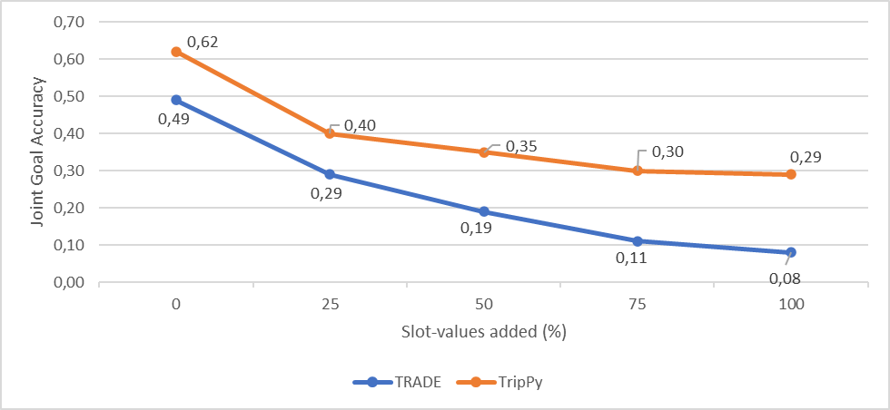
Impact on Dialogue State Tracking (DST)
MOTIVATIONS
Hypothesis: Changing slot-values affects DST performance
Experiment: new slot-values (not presents in training) are added to the KB
Results: Both DST models, TRADE and TripPy, show massive decrease in JGA

Slide 11
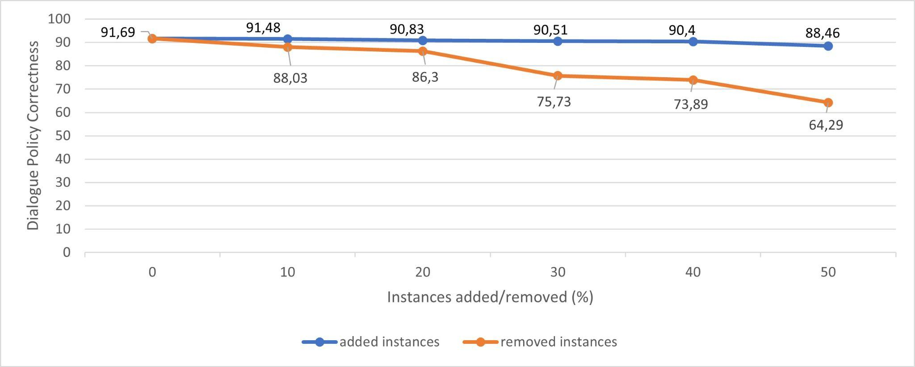
Impact on Dialogue Policy (DP)
MOTIVATIONS
Hypothesis: Changing KB instances affects DP performance
Experiment 1: New KB instances are incrementally added
Experiment 2: KB instances are incrementally removed
Results: Reducing instances bring a significant degradation on dialog policy

Slide 12
Data Driven Conversational Systems
MOTIVATIONS
Training Dialogues
Domain Knowledge Base
Expert / Crowd
DST
model
DP
model
NLG
model
User
Dialogue State Tracking
Dialogue Policy
Natural Language Generation

Slide 13
Managing Domain Changes: New Expert/Crowd Datasets
MOTIVATIONS
New Training Dialogues
New Domain Knowledge Base
Expert / Crowd
DST
model
DP
model
NLG
model
User
Dialogue State Tracking
Dialogue Policy
Natural Language Generation

Slide 14

Managing Domain Changes: Dialogue Adaptation
MOTIVATIONS
New Training Dialogues
New Domain Knowledge Base
Dialogue Adaptation
DST
model
DP
model
NLG
model
User
Dialogue State Tracking
Dialogue Policy
Natural Language Generation

Slide 15
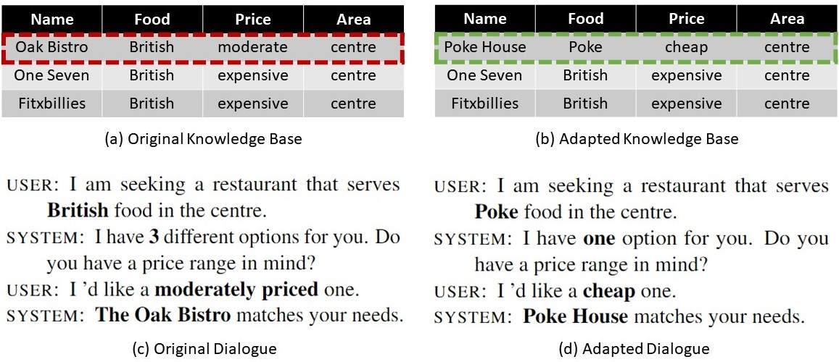
Dialogue Adaptation - Example
MOTIVATIONS

Slide 16
Dialogue Adaptation
Requirements
METHODOLOGY
Dialogue adaptation consists in modifying a task-oriented dialogue D_0 collected for a certain knowledge base KB_0 in order to produce new dialogues D_1, which should be consistent with a knowledge base KB_1
Maintain dialogue coherence
Preserve domain adherence
Maintain Linguistic Variability
Respect morpho-syntactic constraints

Slide 17
Dialogue Adaptation
APPROACH
Dialogue Source
U: “I’m looking for a British food restaurant”

Slide 18
Dialogue Adaptation - Substitution
APPROACH
Dialogue Source
U: “I’m looking for a <Food> food restaurant”
KB search
Grounding
Prompting
Fine-tuning

Slide 19
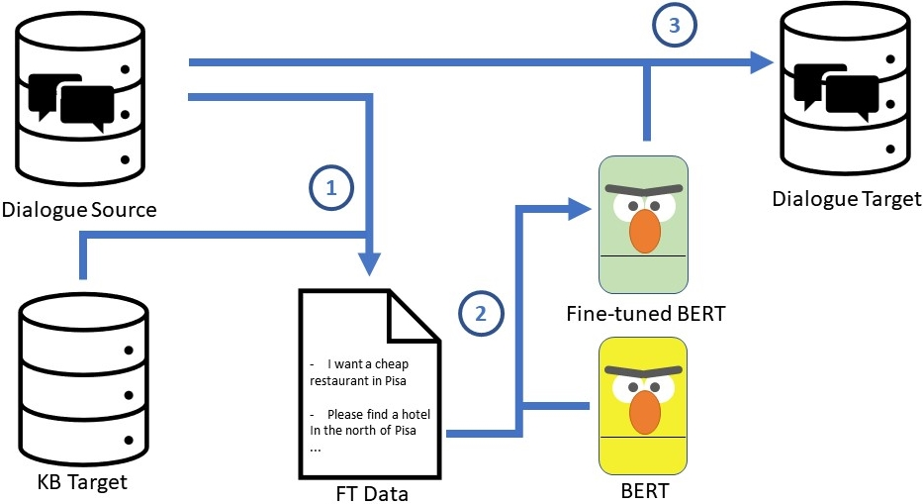
Dialogue Adaptation: KB search
APPROACH
Dialogue Source
U: “I’m looking for a <Food> food restaurant”
KB search

Slide 20
Dialogue Adaptation: KB search
APPROACH
Dialogue Target
U: “I’m looking for a Trentino food restaurant”
KB search

Slide 21


Dialogue Adaptation: KB search
APPROACH
PROs:
Controlled environment
Easy design
CONs:
Rule-based can’t cover it all
Linguistic issues
High human effort needed

Slide 22
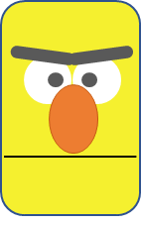
Dialogue Adaptation: Asking a LLM
APPROACH
Dialogue Source
U: “I’m looking for a <Food> food restaurant”
Language Model

Slide 23
Dialogue Adaptation: Asking a LLM
APPROACH
Dialogue Target
U: “I’m looking for a Trentino food restaurant”
NOT FEASIBLE
Language Model

Slide 24
Dialogue Adaptation: Asking a LLM
APPROACH
CONs:
The LLM knows nothing about the domain

Slide 25
Dialogue Adaptation: Grounding
APPROACH
Dialogue Source
U: “I’m looking for a <Food> food restaurant”
Grounding
Language Model

Slide 26
Dialogue Adaptation: Grounding
APPROACH
Dialogue Target
U: “I’m looking for a Trentino food restaurant”
Grounding
Language Model

Slide 27
Dialogue Adaptation: Grounding
APPROACH
PROs:
Semi-controlled environment
Solves linguistic issues
CONs:
Needs to define constraints in advance
Domain knowledge needs to be contained in LM

Slide 28
Dialogue Adaptation: Prompting
APPROACH
Dialogue Source
U: “I’m looking for a <Food> food restaurant”
PROMPT:
[X] I want a restaurant in Trento with [Z] type of food
[Z]: Trentino

Slide 29
Dialogue Adaptation: Prompting
APPROACH
Dialogue Target
U: “I’m looking for a Trentino food restaurant”
PROMPT:
[X] I want a restaurant in Trento with [Z] type of food
[Z]: Trentino

Slide 30
Dialogue Adaptation: Prompting
APPROACH
PROs:
No need of KB
Leverages LM knowledge
CONs:
Domain knowledge needs to be contained in LM
Needs prompt engineering

Slide 31
Dialogue Adaptation: Fine-tuning a LM
APPROACH
Dialogue Source
U: “I’m looking for a <Food> food restaurant”
Language Model
Fine-tuned
Language Model

Slide 32
Dialogue Adaptation: Fine-tuning a LM
APPROACH
Dialogue Target
U: “I’m looking for a Trentino food restaurant”
Language Model
Fine-tuned
Language Model

Slide 33
Dialogue Adaptation: Fine-tuning a LM
APPROACH
PROs:
Linguistic issues solved
Leverages both LM and domain knowledge
CONs:
Cost of creating fine-tuning patterns from KB target

Slide 34
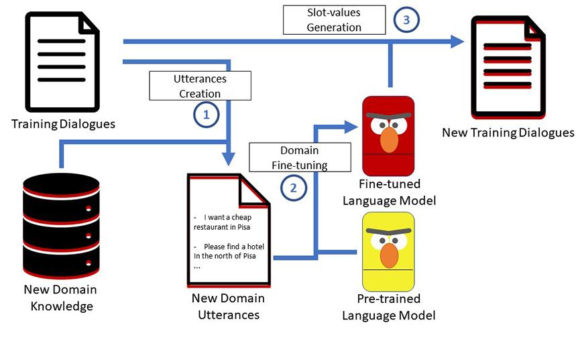
Dialogue Adaptation through FT
APPROACH

Slide 35
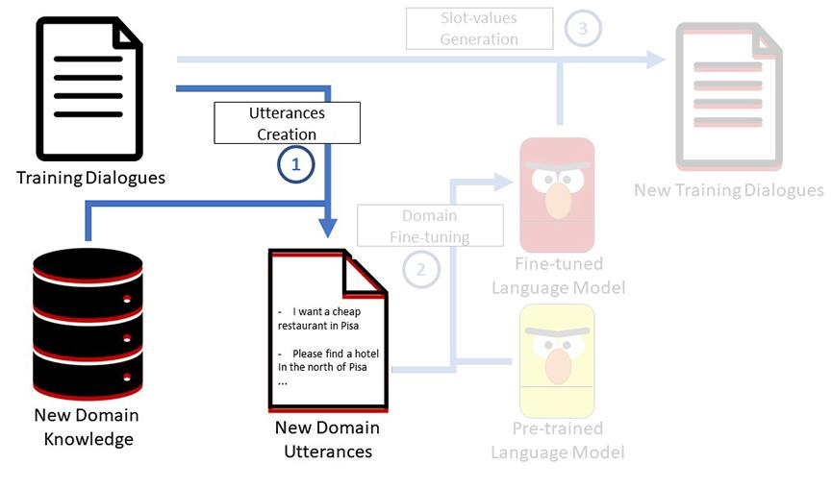
1- Utterances Creation
APPROACH

Slide 36
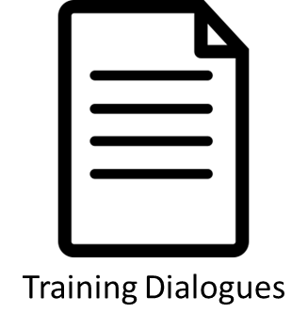
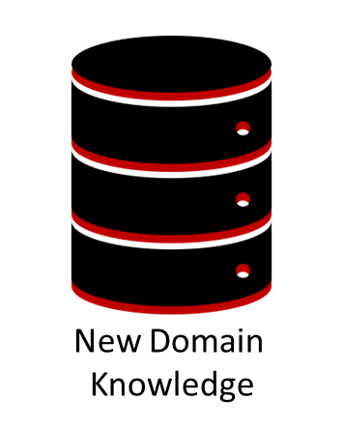
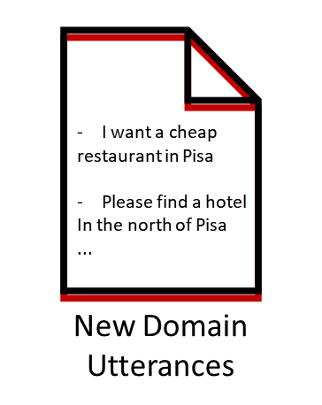
APPROACH
randomly extract
“I’m looking for a british food restaurant”
“I’m looking for a <restaurant-food> food restaurant”
restaurant-food
Trentino
“I’m looking for a Trentino food restaurant”
Italian
“I’m looking for a Italian food restaurant”
query
Sicilian
“I’m looking for a Sicilian food restaurant”
Indian
“I’m looking for a Indian food restaurant”
…

Slide 37
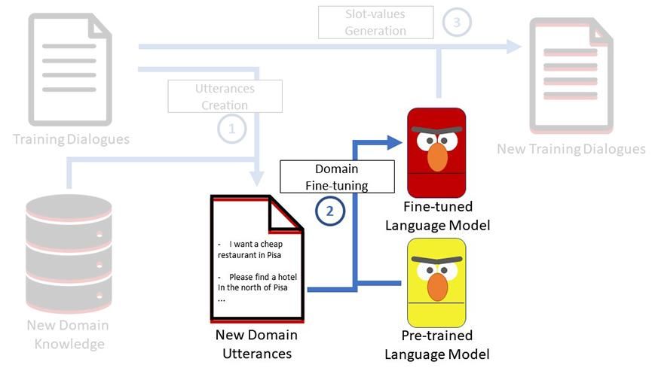
2- Domain Fine-tuning
APPROACH

Slide 38
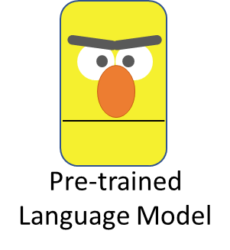
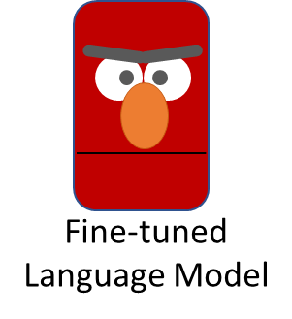
APPROACH

Slide 39
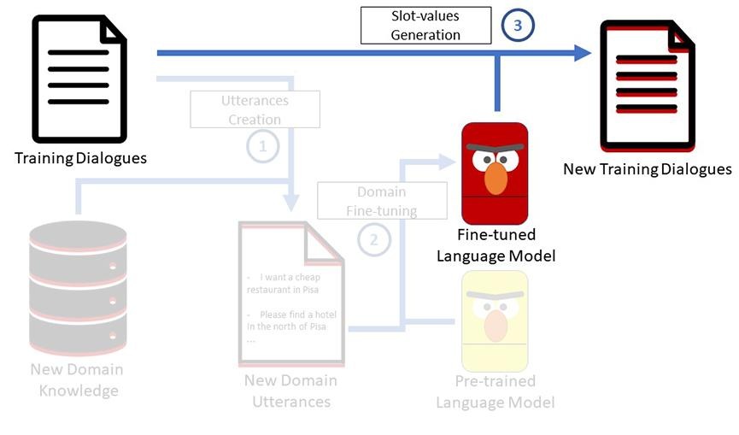
3- Slot-values Generation
APPROACH

Slide 40
3 - Slot-value Generation
APPROACH
“I’m looking for a british food restaurant”

Slide 41
3 - Slot-value Generation
APPROACH
“I’m looking for a [MASK] food restaurant”

Slide 42
3 - Slot-value Generation
APPROACH
“I’m looking for a Trentino food restaurant”
trattoria
Trentino
Italian
Sicilian
pizzeria

Slide 43
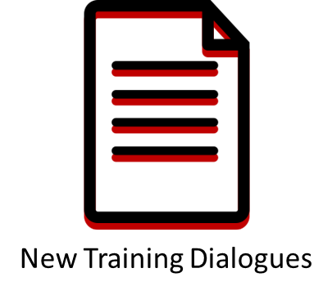
3 - Slot-value Generation
APPROACH
“I’m looking for a Trentino food restaurant”

Slide 44
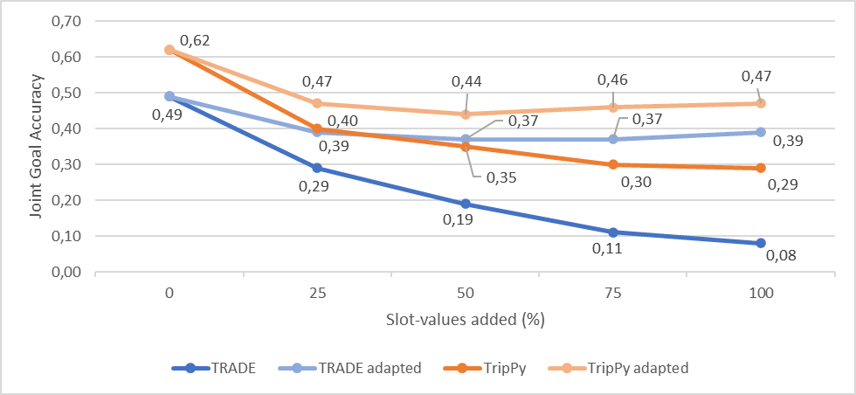
Results
Experiment: We trained the DST models TRADE and TripPy on the datasets adapted through Fine-tuning Dialogue Adaptation, and compared the performances with the No-Adaptation setting.
Both models show a significant improvement in the JGA performances.

Slide 45
Conclusion
Domain changes cause a degradation of model’s performance.
Techniques for adapting training dialogues are needed.
Fine-tuned language models for generating slot-values shows encouraging results.
Many other different dialogue adaptation strategies are possible (e.g. generating the whole sentence).

Slide 46
References
Jie Cao and Yi Zhang. “A Comparative Study on Schema-Guided Dialogue State Tracking”. In: Proceedings of the 2021 Conference of the North American Chapter of the Association for Computational Linguistics: Human Language Technologies. 2021, pp. 782–796.
Zhaojiang Lin et al. “Leveraging Slot Descriptions for Zero-Shot Cross-Domain Dialogue State Tracking”. In: arXiv preprint arXiv:2105.04222 (2021).
Yuheng Du et al. “Schema-Guided Natural Language Generation”. In: arXiv preprint arXiv:2005.05480 (2020).
Yue Feng, Yang Wang, and Hang Li. “A Sequence-to-Sequence Approach to Dialogue State Tracking”. In: arXiv preprint arXiv:2011.09553 (2020).
Andrea Madotto, Chien-Sheng Wu, and Pascale Fung. “Mem2seq: Effectivelyincorporating knowledge bases into end-to-end task-oriented dialog systems”. In: arXiv preprint arXiv:1804.08217 (2018).

Slide 47
References
Sainbayar Sukhbaatar et al. “End-to-end memory networks”. In: arXiv preprint arXiv:1503.08895 (2015).
Vardaan Pahuja et al. “A Systematic Investigation of KB-Text Embedding Alignment at Scale”. In: arXiv preprint arXiv:2106.01586 (2021).
J Neeraja, Vivek Gupta, and Vivek Srikumar. “Incorporating External Knowledge to Enhance Tabular Reasoning”. In: arXiv preprint arXiv:2104.0424 (2021).
Puhai Yang, Heyan Huang, and Xian-Ling Mao. “Comprehensive Study: How the Context Information of Different Granularity Affects Dialogue State Tracking?” In: arXiv preprint arXiv:2105.03571 (2021).
Jinyu Guo et al. “Dual Slot Selector via Local Reliability Verification for Dialogue State Tracking”. In: arXiv preprint arXiv:2107.12578 (2021).
Constantinos Karouzos, Georgios Paraskevopoulos, and Alexandros Potamianos. “UDALM: Unsupervised Domain Adaptation through Language Modeling”. In: arXiv preprint arXiv:2104.07078 (2021).

Slide 48
References
Nghia Ngo Trung, Duy Phung, and Thien Huu Nguyen. “Unsupervised Domain Adaptation for Event Detection using Domain-specific Adapters”. In: Findings of the Association for Computational Linguistics: ACL-IJCNLP 2021. 2021, pp. 4015–4025.
Bo Zhang et al. “Matching Distributions between Model and Data: Cross-domain Knowledge Distillation for Unsupervised Domain Adaptation”. In: Proceedings of the 59th Annual Meeting of the Association for Computational Linguistics and the 11th International Joint Conference on Natural Language Processing (Volume 1: Long Papers). 2021, pp. 5423–5433.
Qingbin Liu et al. “Domain-Lifelong Learning for Dialogue State Tracking via Knowledge Preservation Networks”. In: Proceedings of the 2021 Conference on Empirical Methods in Natural Language Processing. 2021, pp. 2301–2311.
Piyawat Lertvittayakumjorn, Daniele Bonadiman, and Saab Mansour. “Knowledge-Driven Slot Constraints for Goal-Oriented Dialogue Systems”. In: Proceedings of the 2021 Conference of the North American Chapter of the Association for Computational Linguistics: Human Language Technologies. 2021, pp. 3407–3419.

Slide 49
References
Tiziano Labruna and Bernardo Magnini. “Addressing Slot-Value Changes in Task-oriented Dialogue Systems Through Dialogue Domain Adaptation”. In: International Conference Recent Advances In Natural Language Processing (2021).
Tiziano Labruna and Bernardo Magnini. “From Cambridge to Pisa: A Journey into Cross-Lingual Dialogue Domain Adaptation for Conversational Agents”. (2021).
Tiziano Labruna and Bernardo Magnini. “Fine-Tuning BERT for Generative Dialogue Domain Adaptation”. In: Text, Speech, and Dialogue. 2022, pp. 490–501.

Slide 50

Thank you
Tiziano Labruna¹² – tlabruna@fbk.eu
Bernardo Magnini¹ - magnini@fbk.eu
¹ Fondazione Bruno Kessler
² Free University of Bolzano-Bozen

